Slide 1

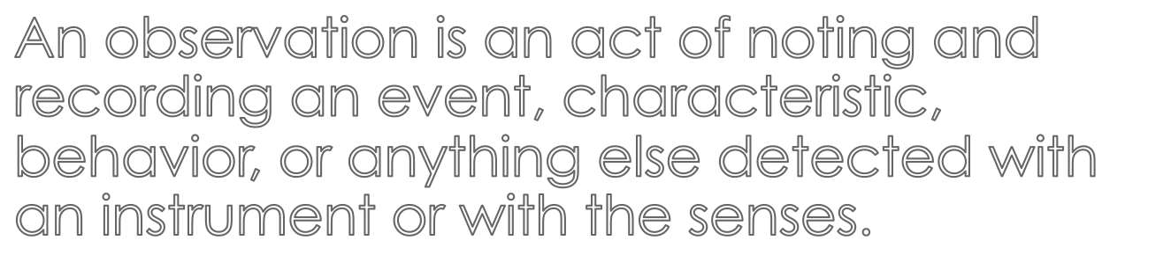

Slide 2

Quantitative observations- can be expressed in numbers and include records of time, temperature, mass, distance, and volume
Qualitative observations include the descriptions of sights, sounds, smells, and textures.

Slide 3

A student dissolved 30 grams of Epsom salts in water, poured the solution into a dish, and let the dish sit out uncovered overnight. The next say, she made the following observations of the Epsom salt crystals that grew in the dish.

Slide 4

Quantitative Observations | Qualitative Observations
- Mass = 30 g - mean crystal length = 0.5 cm - Longest crystal length = 2 cm | - Crystals are clear. - Crystals are long, thin, and rectangular. - White crust has formed around the edge of the dish.

